Slide 1
Reference resources I>Clicker
Gabriel Beeler, Librarian
and
Ramchandran
Sethuraman, Ph.D.

Slide 2
In Proquest's "Advanced Search" when would you use the word "OR"?
When you wish to search for occurrences of either of your search terms
When you want to exclude a particular search term
When you want to search for full-text articles
When you have retrieved too many matches and wish to make your search more specific

Slide 3
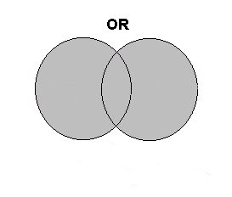
In Proquest's "Advanced Search" when would you use the word "OR"?
When you wish to search for occurrences of either of your search terms

Slide 4
This Venn Diagram is and an example of what Boolean Operator? Hint ;) it gives you more results.
OR
NOT
AND
IF
None of the above

Slide 5
This Venn Diagram is and an example of what Boolean Operator?
OR
NOT
AND
IF
None of the above
OR gives you more!

Slide 6
What is a thumb drive or Flash drive?
small portable computer data storage device
A floppy disk
a file that is unreadable
An eBook
None of the above

Slide 7
What is a thumb drive or Flash drive?
small portable computer data storage device
A floppy disk
a file that is unreadable
An eBook
None of the above

Slide 8
What type of book is this?
Reserve
Periodical
Non-Fiction
Reference
Fiction

Slide 9
What type of book is this?
Reserve
Periodical
Non-Fiction
Reference
Fiction

Slide 10
Which of the following are uses for reference books?
They summarize, digest, or review the literature on a topic
Each is specifically structured to answer certain kinds of questions
They provide important background information to help focus your research questions
They point to literature contained in books, journals, and other publications
All of the Above

Slide 11
Which of the following are uses for reference books?
They summarize, digest, or review the literature on a topic
Each is specifically structured to answer certain kinds of questions
They provide important background information to help focus your research questions
They point to literature contained in books, journals, and other publications
All of the Above

Slide 12
Which statement is NOT characteristic of a subject encyclopedia?
Articles are produced by recognized scholars
Articles provide an in-depth bibliography
They cover a wide range of knowledge at a basic level
They outline important concepts, issues, and arguments on a topic
All of the Above

Slide 13
Which statement is NOT characteristic of a subject encyclopedia?
Articles are produced by recognized scholars
Articles provide an in-depth bibliography
They cover a wide range of knowledge at a basic level
They outline important concepts, issues, and arguments on a topic
All of the Above

Slide 14
A compilation of citations to books, journal articles, and reports about a particular topic or person is called:
Bibliography
Glossary
Index
Thesaurus
All of the Above

Slide 15
A compilation of citations to books, journal articles, and reports about a particular topic or person is called:
Bibliography
Glossary
Index
Thesaurus
All of the Above

Slide 16
Go to thesaurus.com/ What is another word (synonym) for gregarious?
A thesaurus is a
dictionary of
synonyms
and antonyms.
reserved
brilliant
stressed
depressed
social

Slide 17
Go to thesaurus.com/ What is another word (synonym) for gregarious?
A thesaurus is a
dictionary of
synonyms
and antonyms.
reserved
brilliant
stressed
depressed
social

Slide 18
Go to thesaurus.com/ What is another word (synonym) for Placid?
A thesaurus is a
dictionary of
synonyms
and antonyms.
calm
brilliant
stressed
depressed
social

Slide 19
Go to thesaurus.com/ What is another word (synonym) for Placid?
A thesaurus is a
dictionary of
synonyms
and antonyms.
calm
brilliant
stressed
depressed
social

Slide 20
Go to thesaurus.com/ click on the translator tab at the top of the page. Translate the spanish phrase “yo la tengo” into English:
I need a haircut
I have it
I love librarians
I am tall
I look silly

Slide 21
Go to thesaurus.com/ click on the translator tab at the top of the page. Translate the spanish phrase “yo la tengo” into English:
I need a haircut
I have it
I love librarians
I am tall
I look silly

Slide 22
Search proquest for “Marijuana ” AND “Legalization” for the last 30 days. How many articles are listed for this?
40
25
30
65
61

Slide 23
Search proquest for “Marijuana ” AND “Legalization” for the last 30 days. How many articles are listed for this?
40
25
30
65
61

Slide 24
To Search proquest for The new York Times, what tab would you click on?
Basic
Advanced
Topics
Browse
Publications

Slide 25
To Search proquest for The new York Times, what tab do you click on?
Basic
Advanced
Topics
Browse
Publications

Slide 26
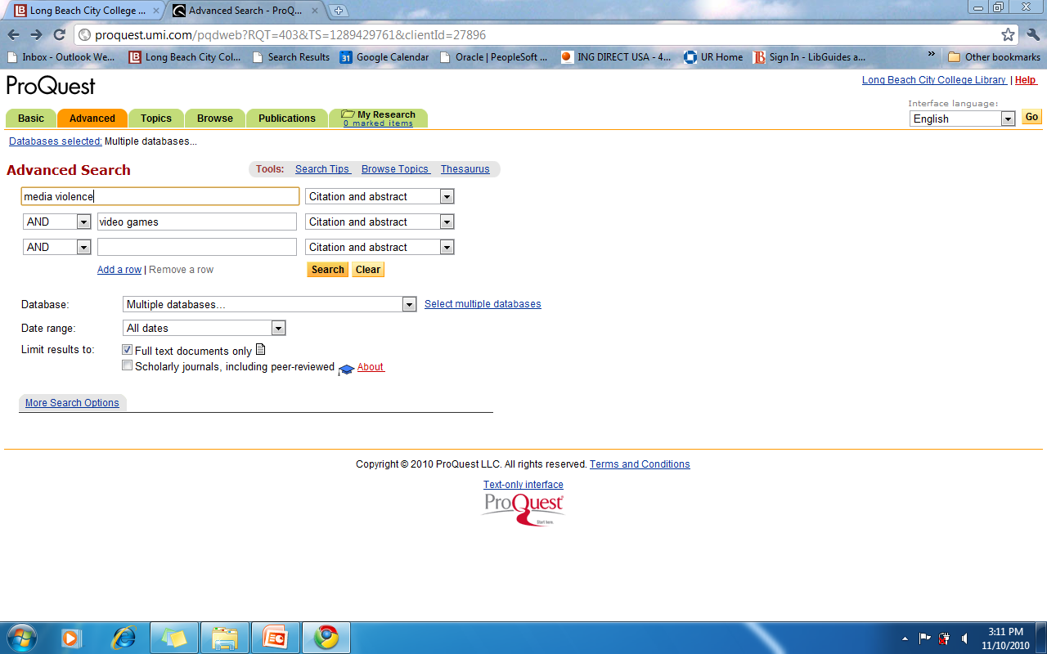
Search proquest for “media violence” AND “video games”, using all dates. How many scholarly articles are listed for this search?
3
25
11
34
8

Slide 27
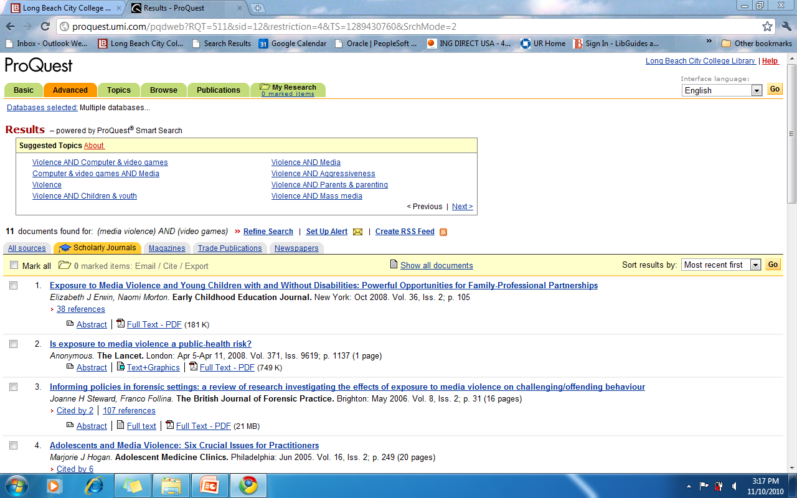
Search proquest for “media violence” AND “video games”, using all dates. How many scholarly articles are listed for this search?
3
25
11
34
8

Slide 28
To Search proquest for ARTICLES CONTAINING ALL OF THEIR WORDS, CLICK THE FOLLOWING BOX:
Basic
Full text documents only
Scholarly journals, including peer-reviewed
Publications
Database:

Slide 29
To Search proquest for ARTICLES CONTAINING ALL OF THEIR WORDS, CLICK THE FOLLOWING BOX:
Basic
Full text documents only
Scholarly journals, including peer-reviewed
Publications
Database:

Slide 30
What's the Fifth most popular flavor of ice cream? Search Google
Neapolitan,
Vanilla,
Chocolate,
Butter pecan,
Strawberry,

Slide 31
Whets the Fifth most popular flavor of ice cream? Search Google
Neapolitan, 4.2%
Vanilla, 29%
Chocolate, 8.9%
Butter pecan, 5.3%
Strawberry, 5.3%

